Slide 1
Olympic Data Analysis using Machine Learning
Institute for Advanced Computing and Software Development (IACSD), Pune
Group No. - 1
Dhavale Alisha Satish 243513
Sharvary Snehadeep Hedau 243548

Slide 2
Objectives
Analyze Olympic athlete data to uncover key insights.
Predict medal wins and performance scores using machine learning models.
Provide actionable insights for future events.

Slide 3
Dataset Overview
Source: Kaggle's Olympic history dataset
https://www.kaggle.com/datasets/heesoo37/120-years-of-olympic-history-athletes-and-results
Number of records : 271116
No. of features : 15
Time span covered : from Athens 1896 to Rio 2016
Key features: ID, Name, Sex, Age, Height, Weight, Team, NOC, Games,
Year, Season, City, Sport, Event, Medal

Slide 4
Data Exploration
Overview of the raw data: types of variables, missing values, duplicates.
Initial observations and patterns.

Slide 5
Data Cleaning
Steps taken to clean the dataset: handling missing values,
correcting inconsistencies, and removing duplicates.
Summary of the cleaned dataset.

Slide 6
Exploratory Data Analysis (EDA)
Distribution of athletes by country, gender, and events.
Time series analysis of medal counts over the years.

Slide 7
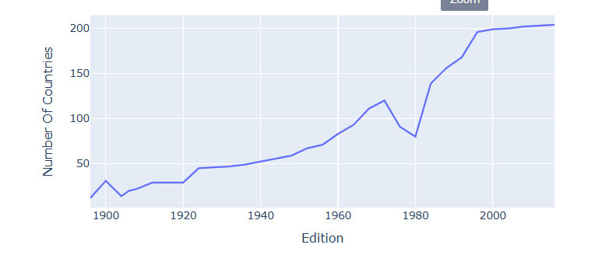
Distribution of Participated Countries over years

Slide 8
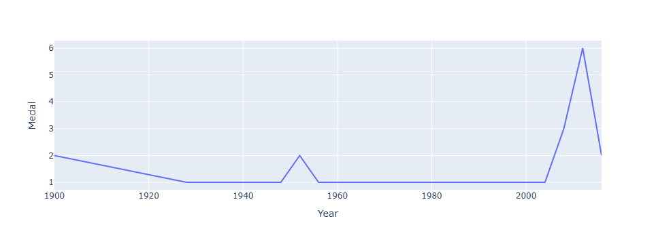
Medal won by India over Years

Slide 9
Visualization of Insights
Visual representations of key findings (e.g., charts, graphs).
Highlight important patterns and trends.

Slide 10
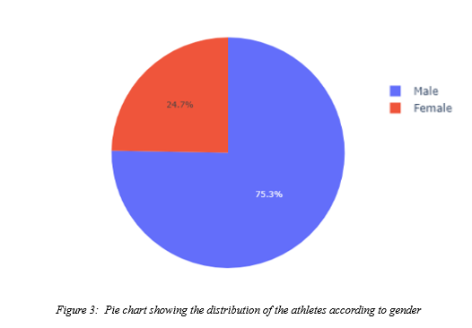
Athlete Gender Ratio

Slide 11
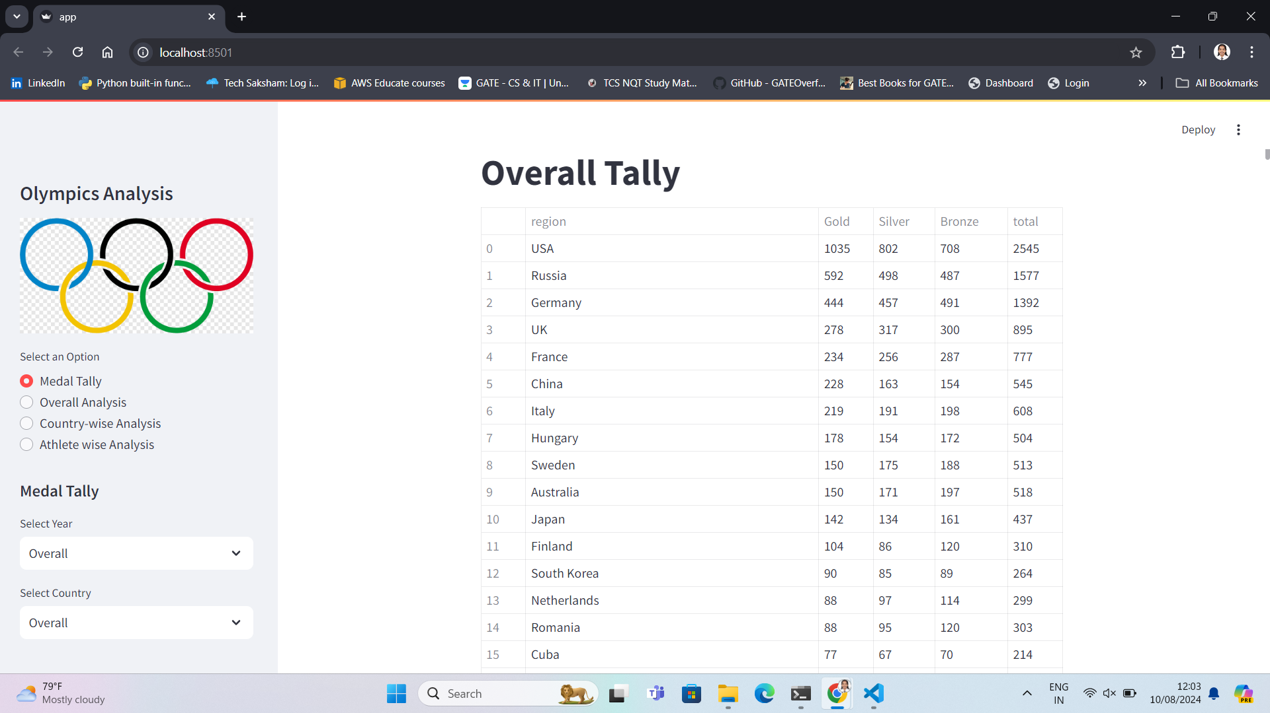
Medal Distribution by Country
Insights into which countries perform best historically.

Slide 12
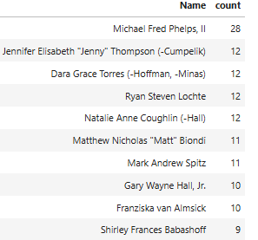
Most Successful Athlete in Swimming

Slide 13
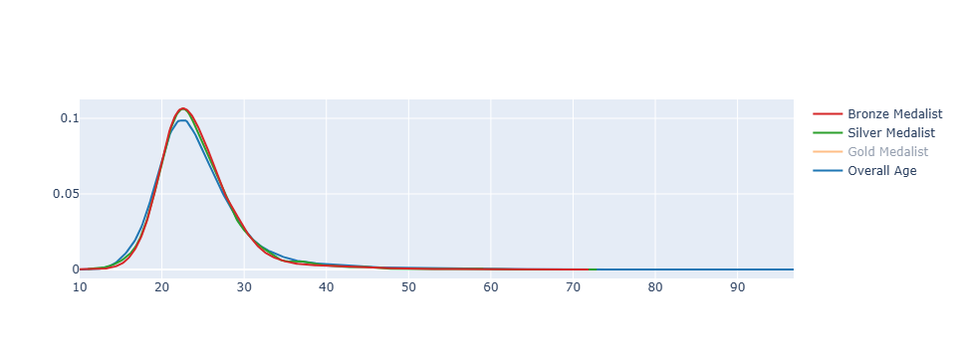
Medal distribution by age

Slide 14
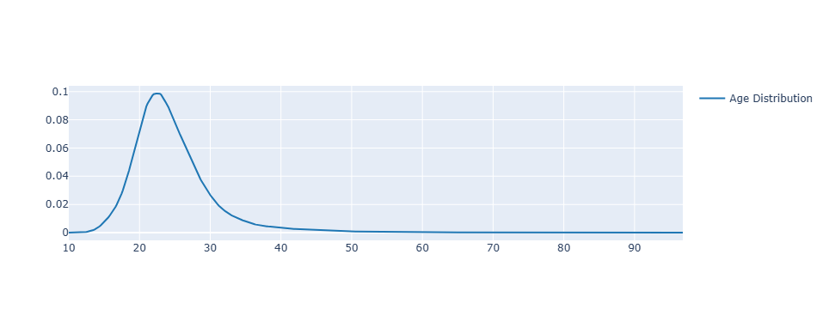
Age Distribution of Athletes

Slide 15
Medal won by India over Years

Slide 16
Correlation Analysis
Insights from the correlations (e.g., age vs. performance, event type vs. medals).
Heatmap or correlation matrix showing relationships between different variables.

Slide 17
Modeling Approach
Selection of machine learning models:
Logistic Regression for medal prediction,
Random Forest for country performance prediction, etc
Naïve bayes
K Nearest Neighbors
SVM
XGBoost
CatBoost
Best performing Model :Catboost

Slide 18
Model Evaluation
Model performance metrics:
Accuracy, Precision, Recall, F1-score, ROC-AUC, etc.
Comparison of different models and their results.

Slide 19
Time series Forecasting
ARIMA (AutoRegressive Integrated Moving Average) is a widely used statistical model for time series forecasting.
It combines three components:
AR (AutoRegressive) for using past values,
I (Integrated) for differencing to make the series stationary, and
MA (Moving Average) for modeling the error term as a linear combination of past errors.
ARIMA is effective for forecasting data with trends or seasonality after differencing.

Slide 20
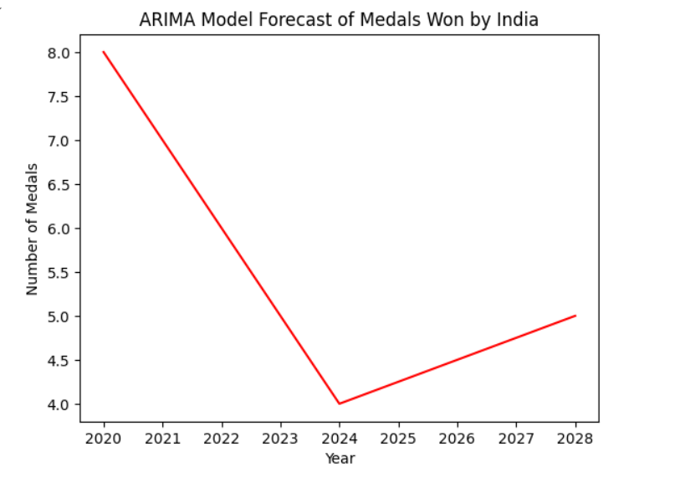

Slide 21
Future Work
Incorporate real-time Olympic data from the 2024 games for ongoing analysis.
Explore advanced modeling techniques, like deep learning.
Potential extensions such as predicting future Olympic outcomes or
analyzing specific sports in-depth.

Slide 22
Thank You!

